Slide 1
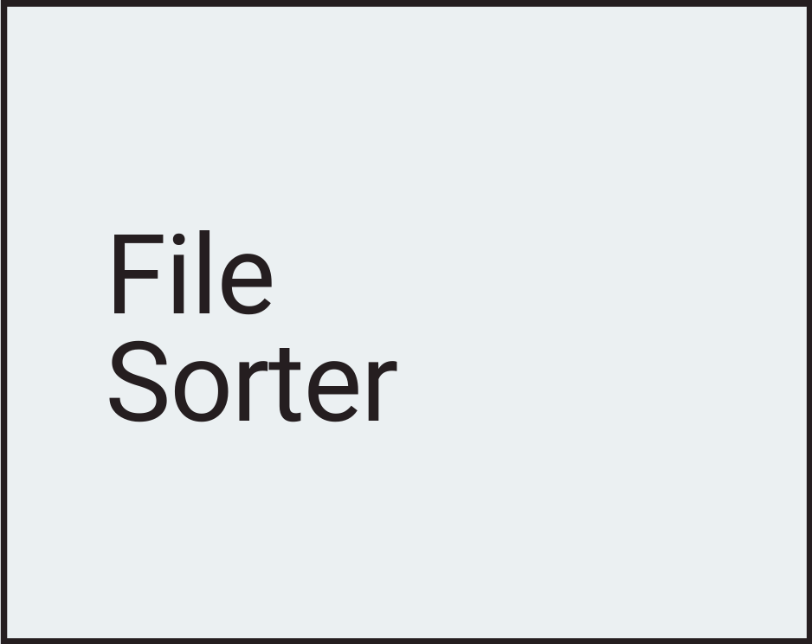
Cairo Lorenzo, 25yo
My talent is calm and creativity
My pitfall is short memory
In 10 years I’ll be keeping developing my projects

Slide 2

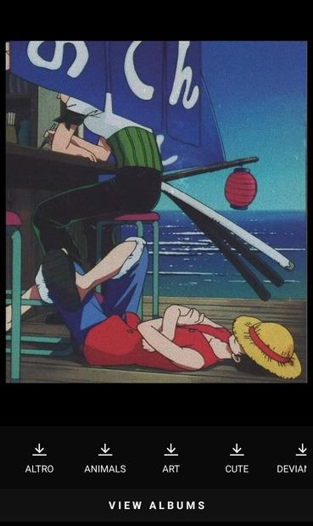
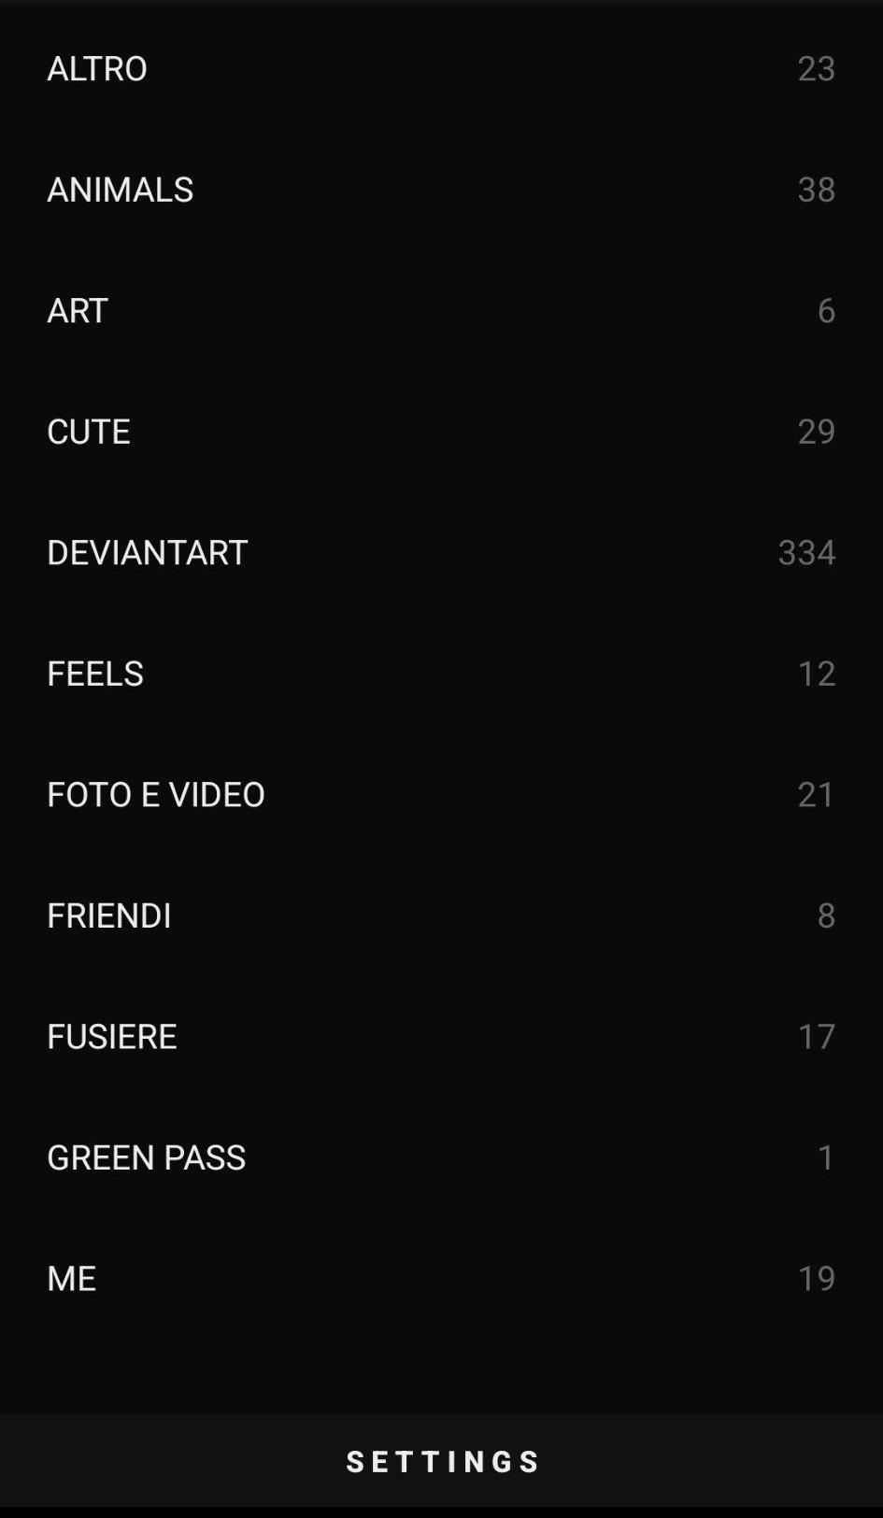
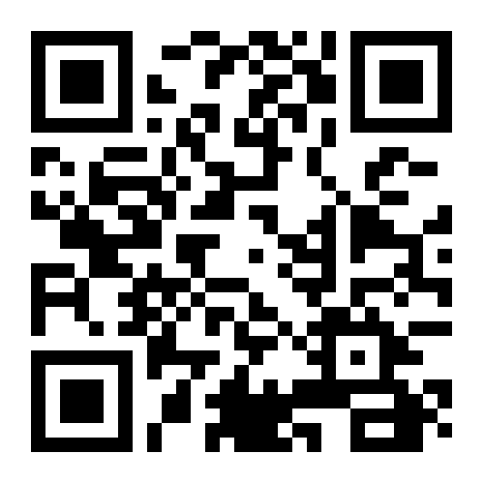
File Sorter
Target age 12+
Tech utility industry
Screens
home page
folder selector
Coming
Soon

Slide 3
Remarks
Competitors/Movers
Slidebox
Simple Gallery
App archivio varie
Est. target size (WW)
~1mln+ Downloads
~500k+ App Purchased
~15mln Impression a month with ~30 ads each month for user
Revenue model
Purchase to access more features
Banner ads
Revenue est.
App Purchased: 0,99 USD
Banner ads: $0,05 CPC.
~495.000 USD by App Purchases and between $500k and $750k by Banner ads.
data source: Slide Box, Simple Gallery, Simple Gallery PRO
Interested? See more

